Slide 1


Slide 2
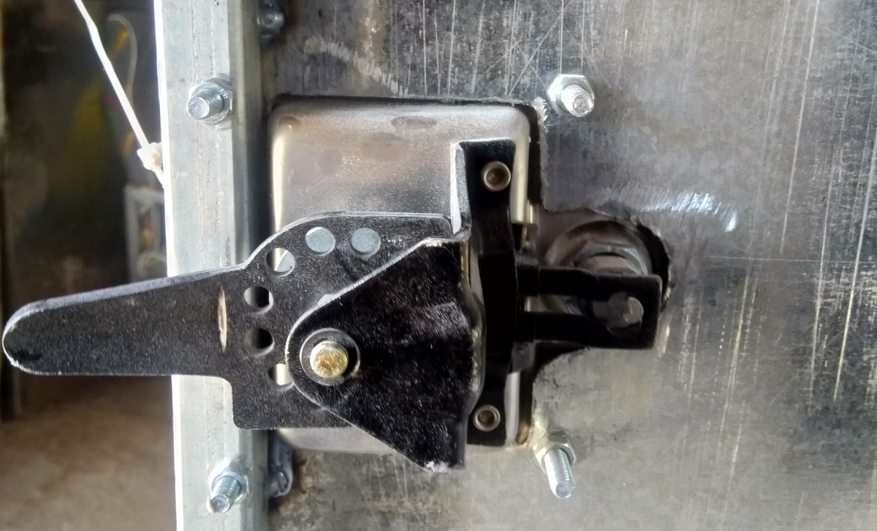
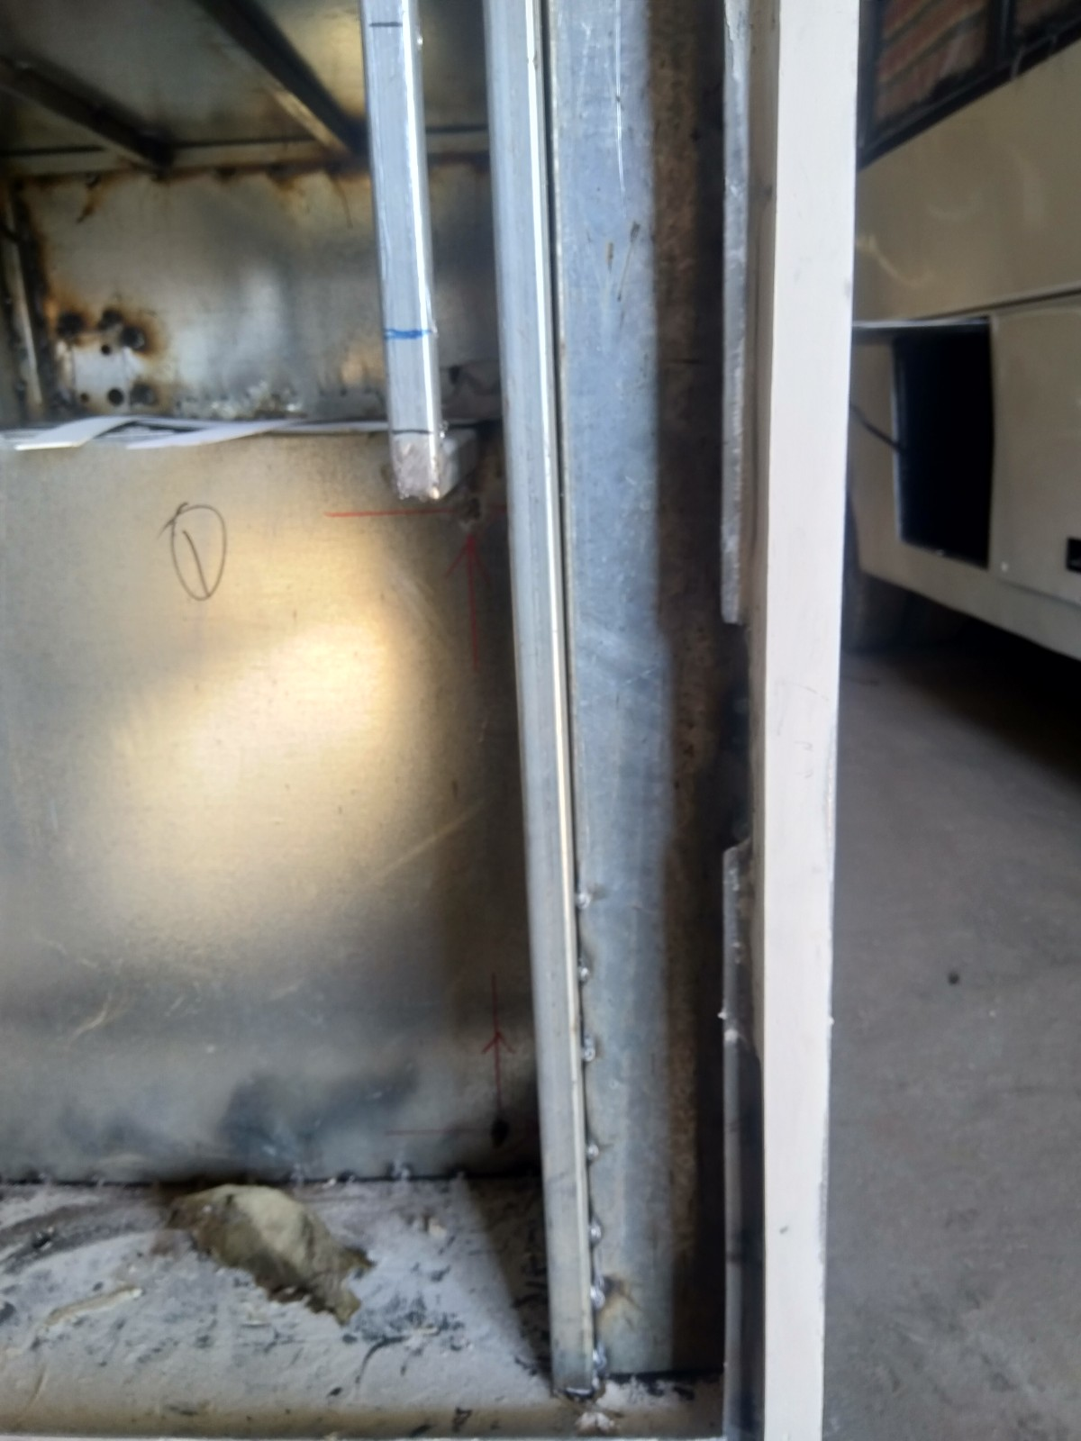
DOOR LOCK PLACEMENT
The locks have not been properly spaced from the door edge as specified in the QC documents hence creating notches in the door cavity plates.

Slide 3
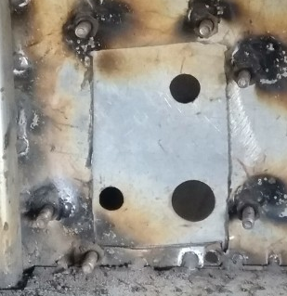
CUT OUTS ACCURACY IN SHAPE
The cutouts are still being done in a haphazard manner hence making the unit look rough in terms of finish as seen in the attached picture.

Slide 4
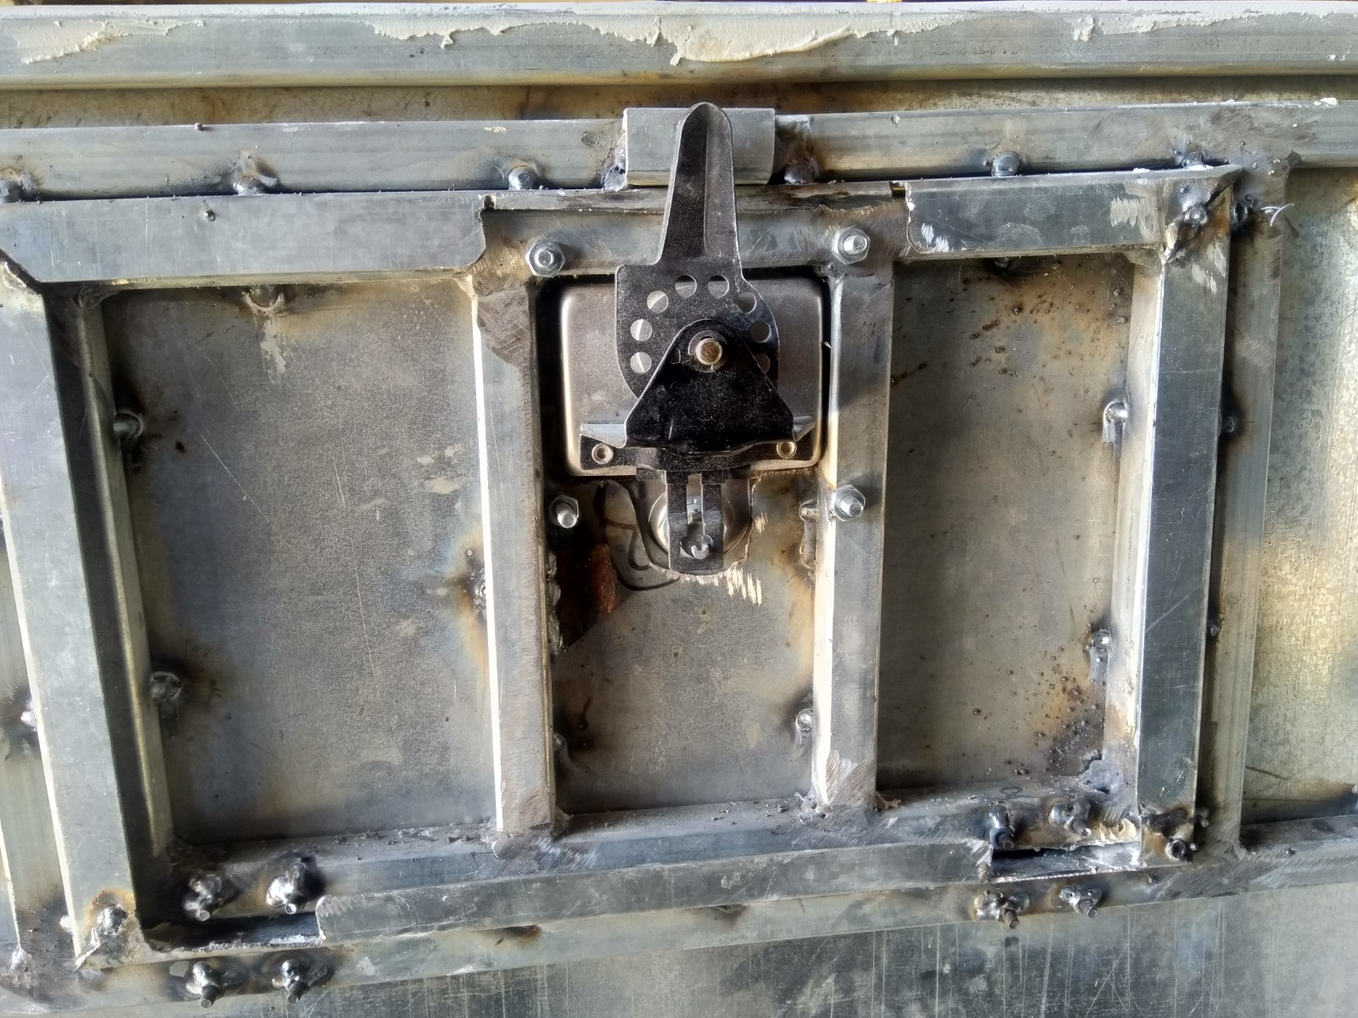
TABLET DOOR FINISH
The tablet door finish looks too rough due to the notches cut on the plates. As discussed this can be avoided by moving the lock downwards and cutting off the bolt bodies after welding their nuts to the body.

